Slide 1

To-Do List App
A simple task management application
A web-based application for managing daily tasks
Allows users to add, edit, and delete tasks
Includes priority levels and due dates
Stores tasks locally for persistent data

Slide 2
Key Features
Task Management: Add, edit, complete, and delete tasks
Priority Levels: High, Medium, Low
Due Dates: Assign deadlines
Local Storage: Saves tasks even after page reload
Responsive UI: Works on all devices

Slide 3
Technologies Used
HTML: Defines the app structure
CSS: Provides styling and layout
JavaScript: Handles task management functionality
Local Storage: Persists user data

Slide 4
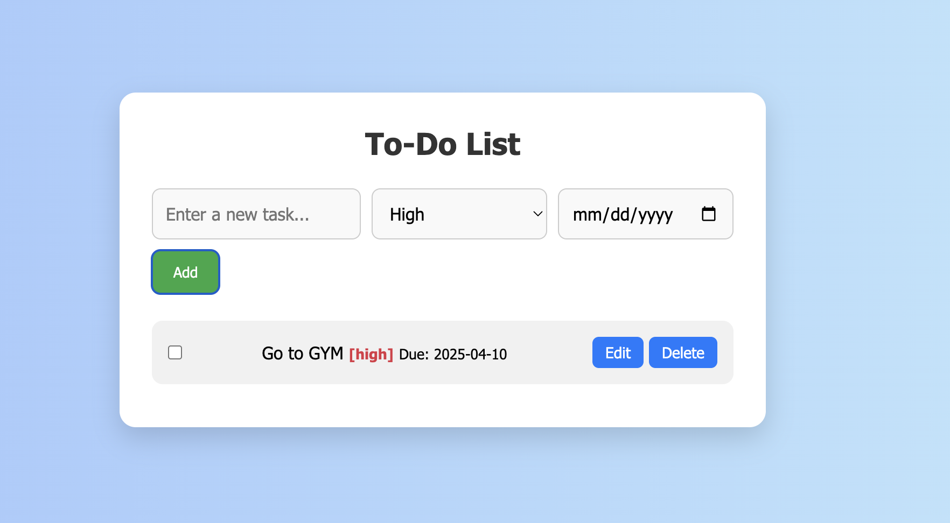
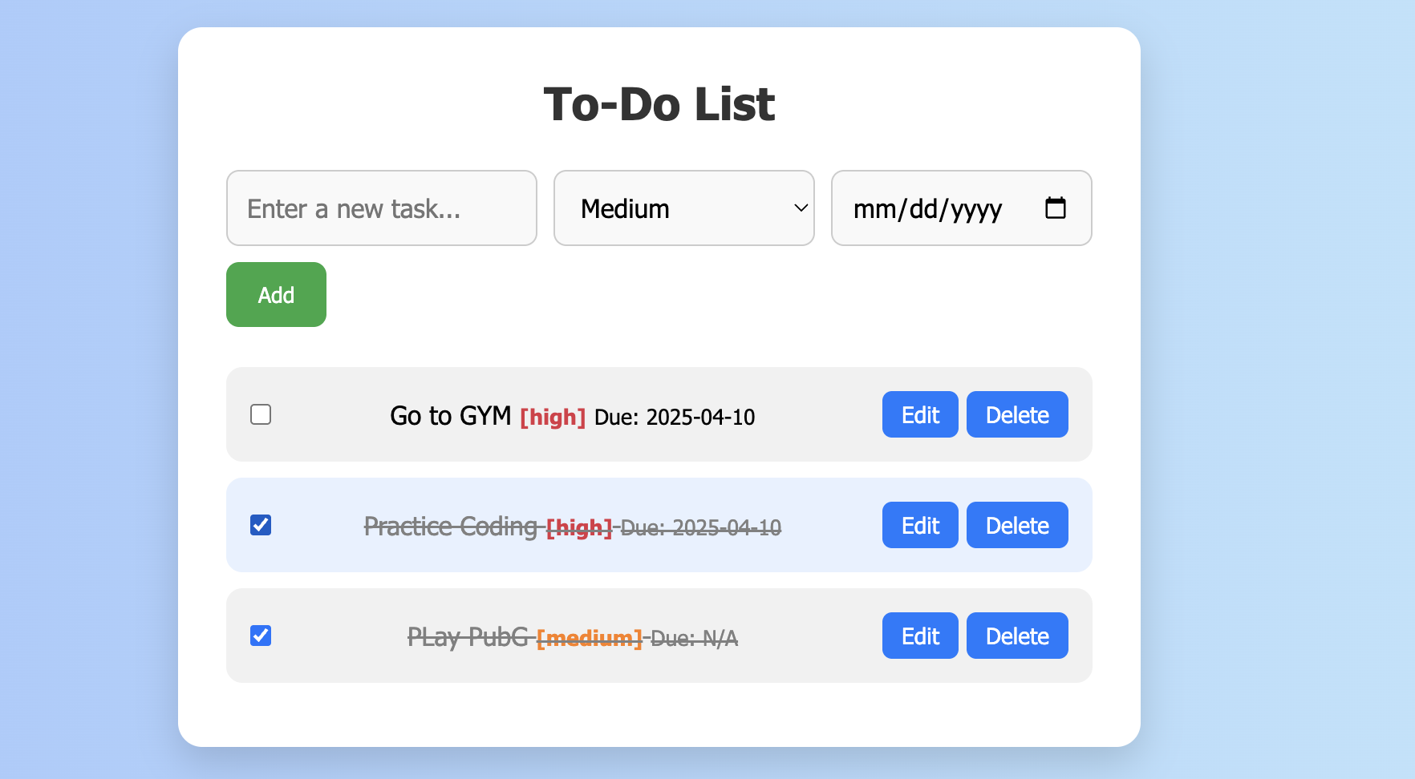
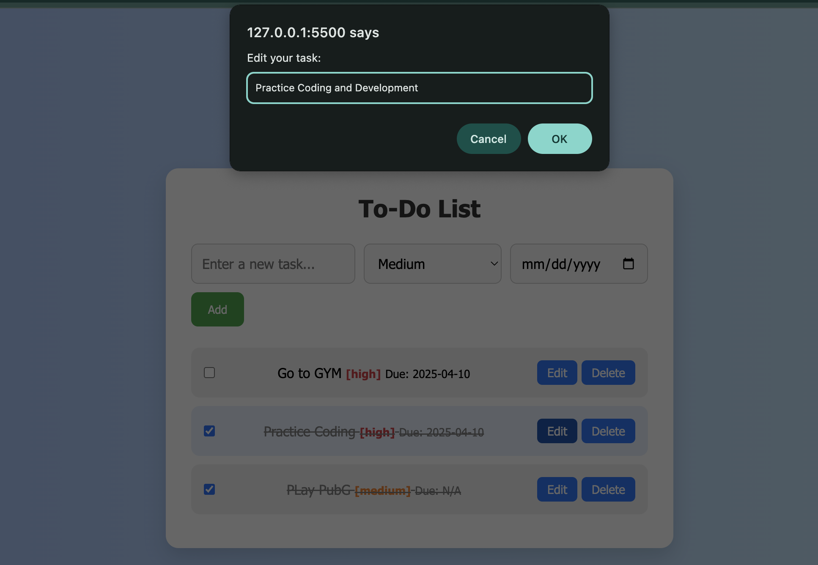
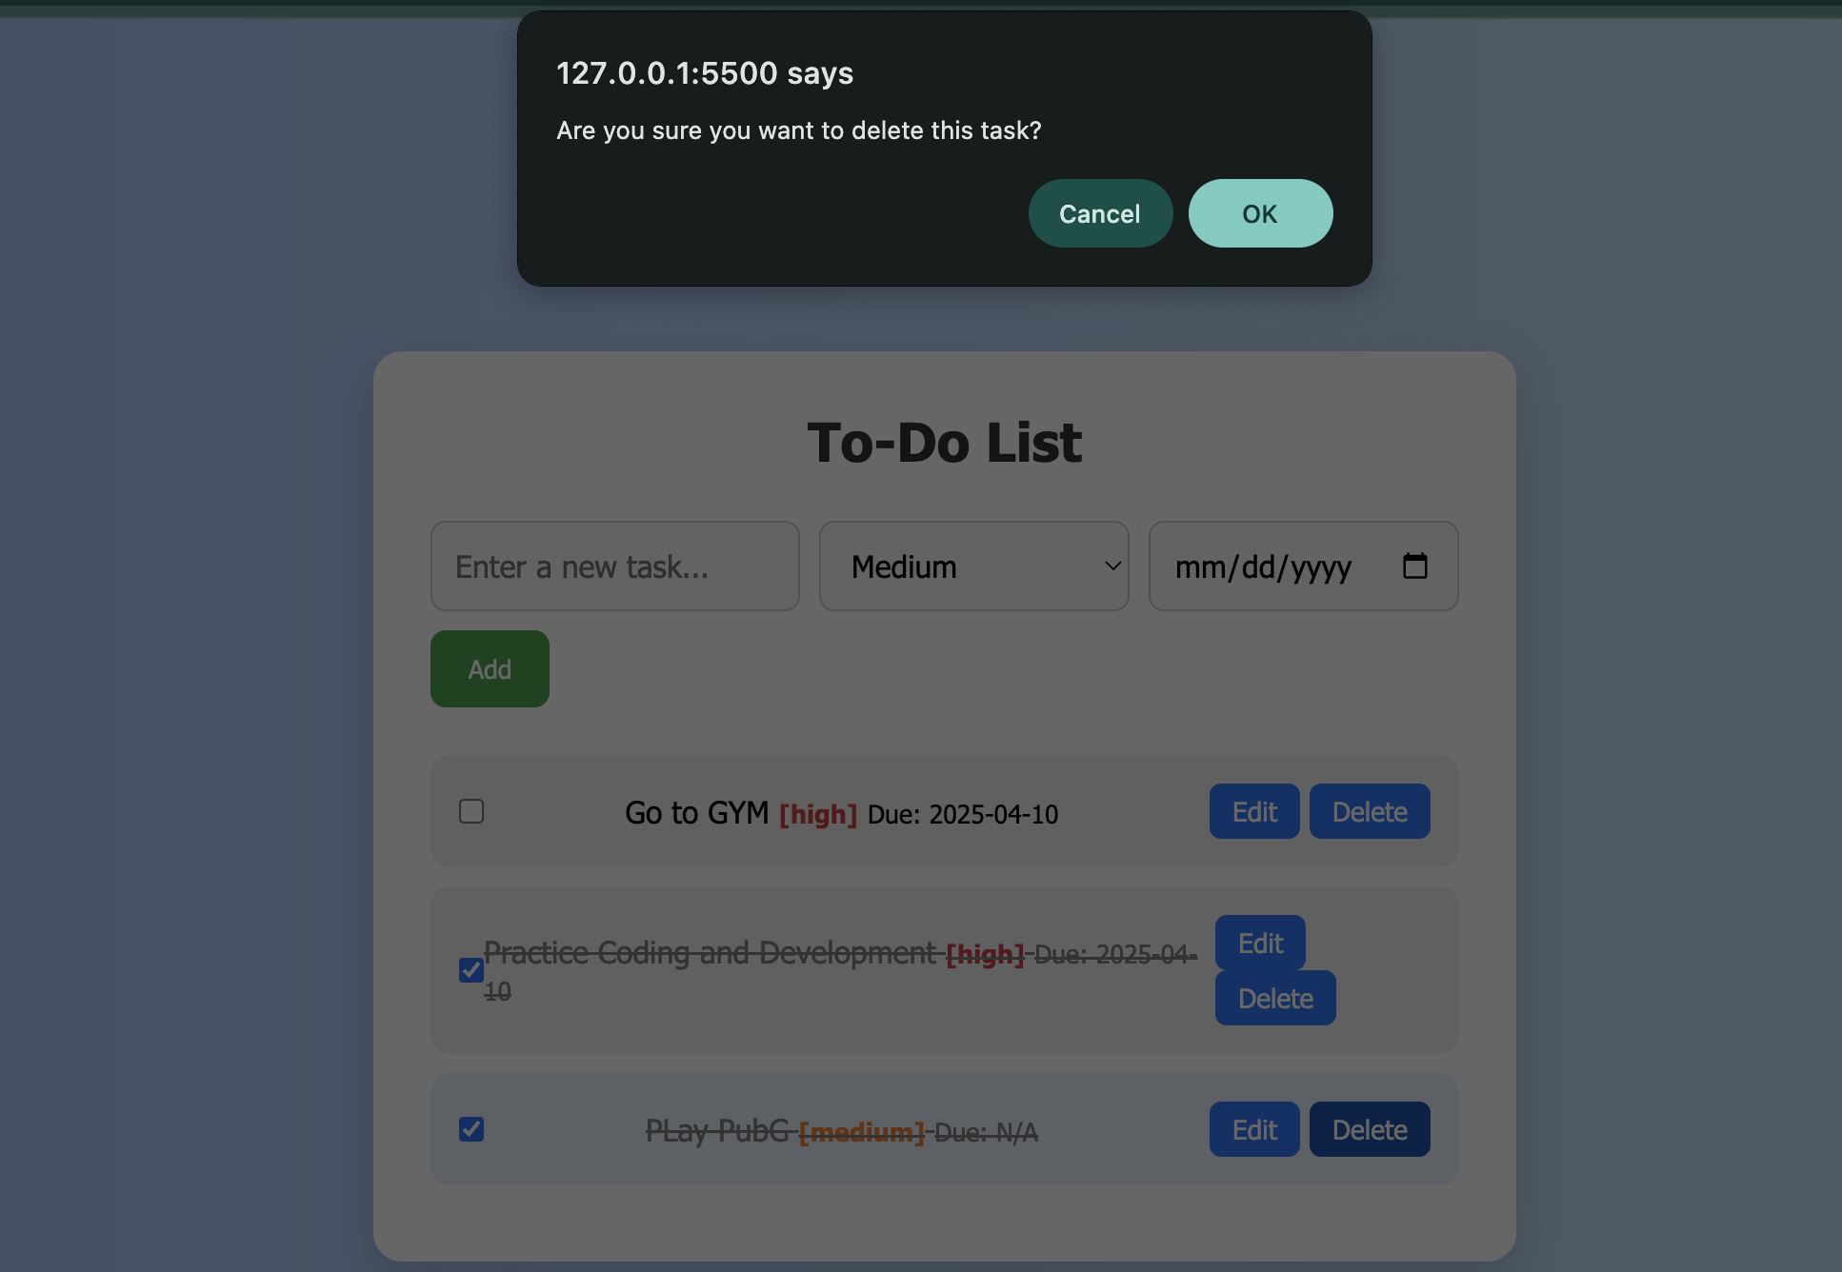
User Interface Preview
Add To-Do
Mark Completed
Edit To-do
Delete To-Do

Slide 5
How It Works
HTML: Defines the input fields, buttons, and task list
CSS: Styles the interface with gradients and hover effects
JavaScript:
Captures user input
Stores and retrieves data from Local Storage
Dynamically updates the task list

Slide 6
Future Improvements
Drag & Drop Sorting: Allow users to reorder tasks
Dark Mode: Improve UI experience
Notifications: Reminders for due tasks
Cloud Sync: Store tasks across multiple devices

